Slide 1
SVM

Slide 2
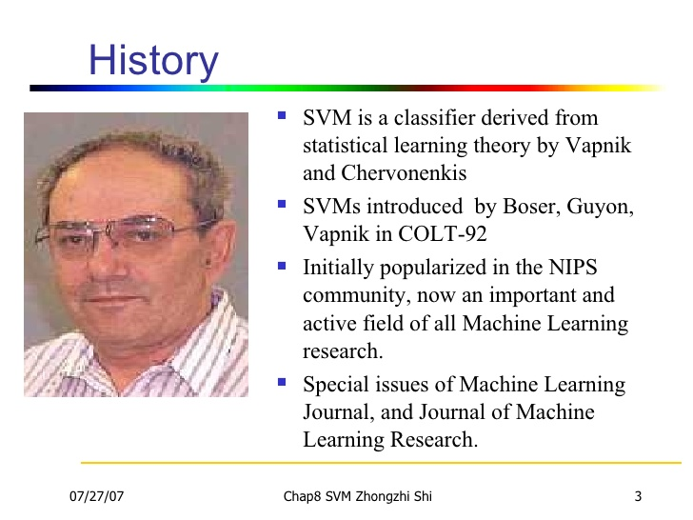

Slide 3
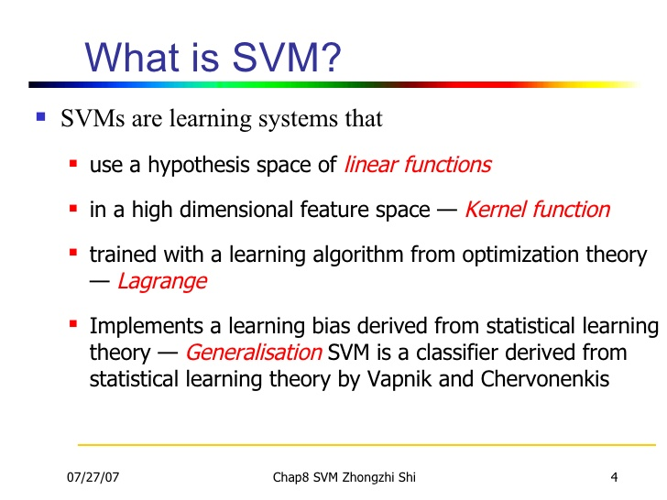

Slide 4
Binary Classification problem二元分類問題
Support Vector Machines
https://www.slideshare.net/nextlib/support-vector-machines

Slide 5
Hard-linear Classification

Slide 6
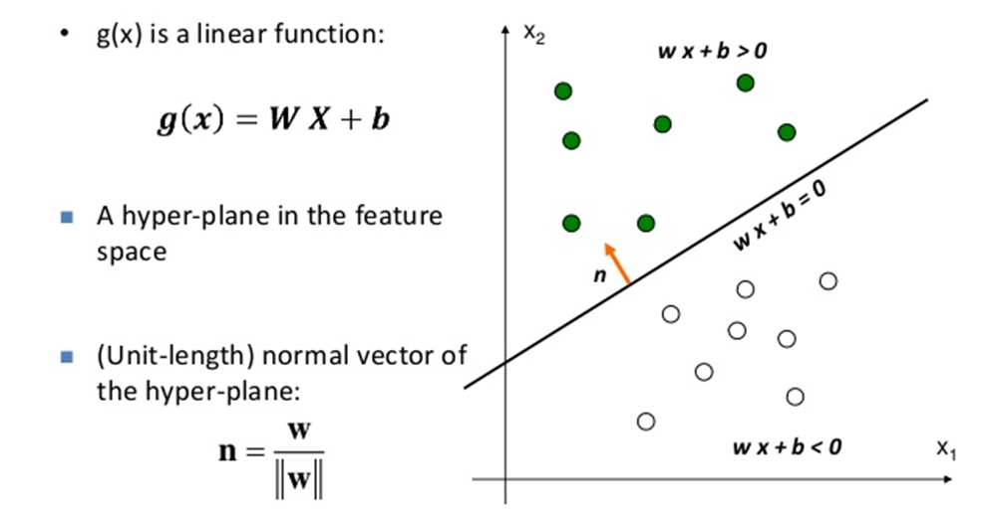
Support Vector Machine without tears
https://www.slideshare.net/ankitksharma/svm-37753690

Slide 7
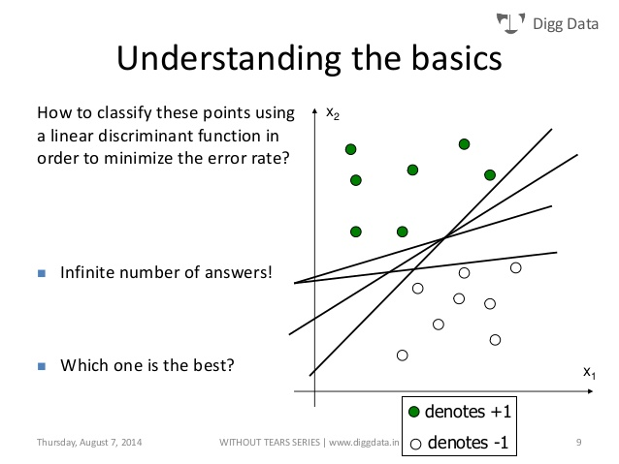
Support Vector Machine without tears
https://www.slideshare.net/ankitksharma/svm-37753690

Slide 8
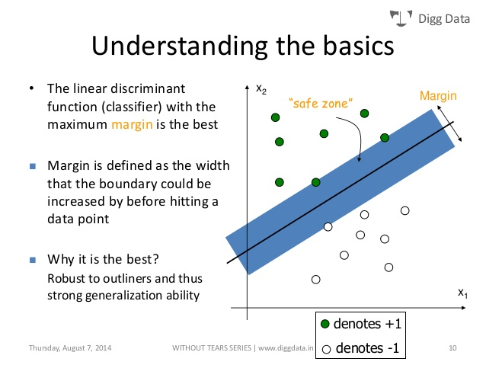

Slide 9
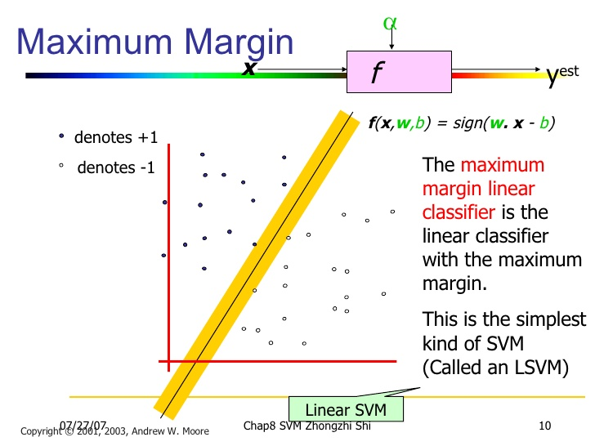
Support Vector Machines
https://www.slideshare.net/nextlib/support-vector-machines

Slide 10
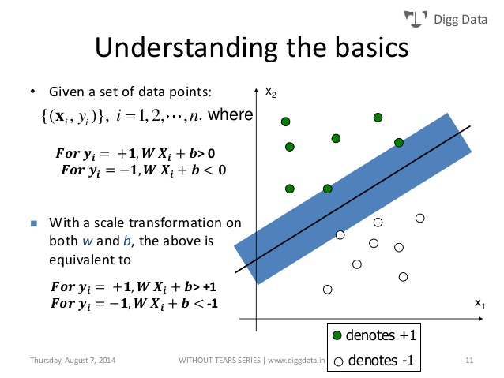

Slide 11
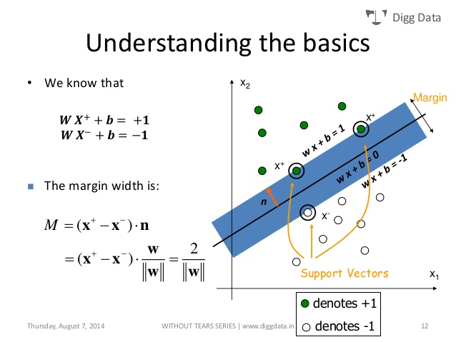

Slide 12
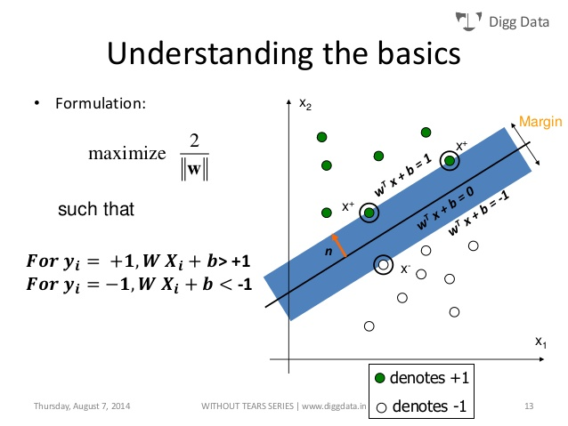

Slide 13
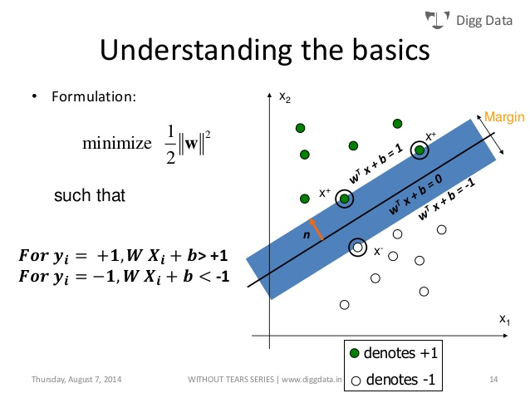

Slide 14


Slide 15
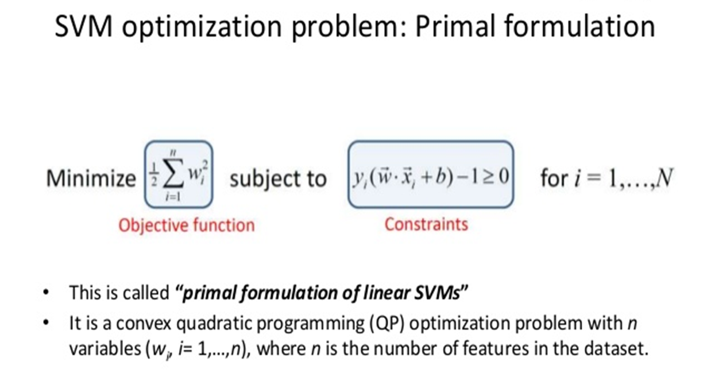

Slide 16
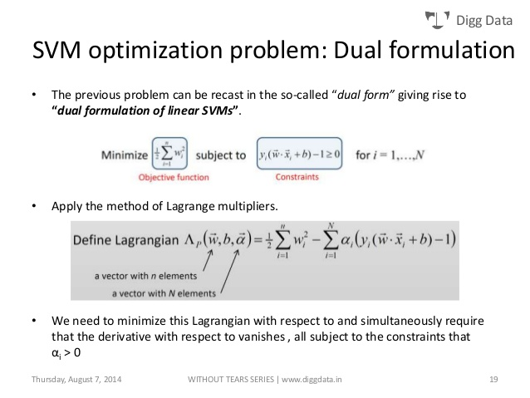

Slide 17
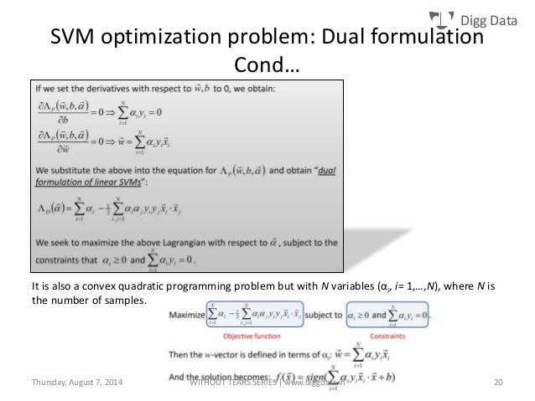

Slide 18
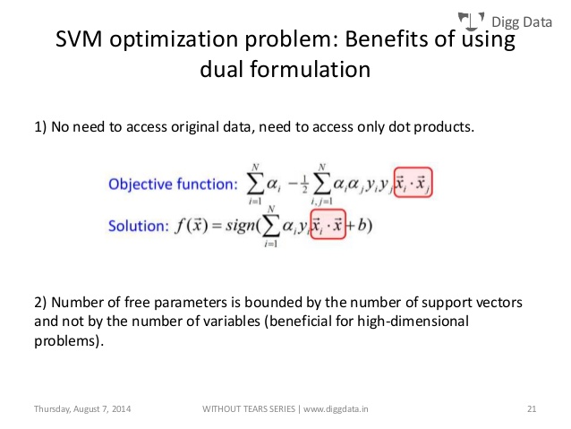

Slide 19
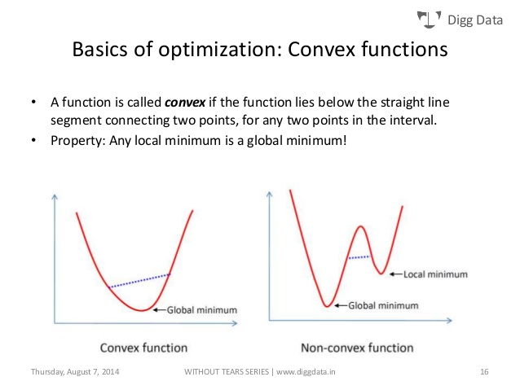

Slide 20
Hyperplane 超平面
Support Vector Machine without tears
https://www.slideshare.net/ankitksharma/svm-37753690

Slide 21
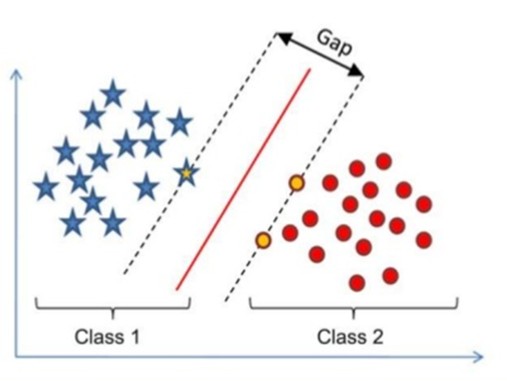
Support Vector Machine without tears
https://www.slideshare.net/ankitksharma/svm-37753690

Slide 22
Soft-linear Classification

Slide 24
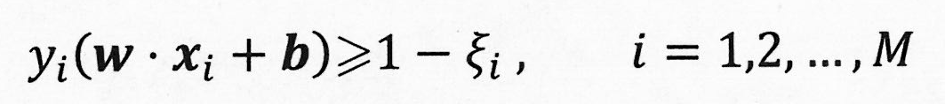
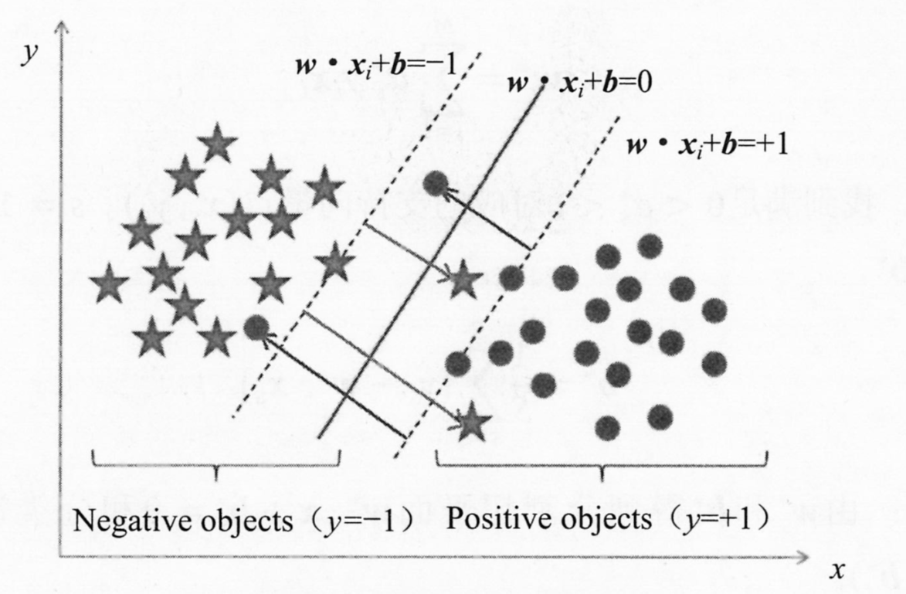

Slide 26
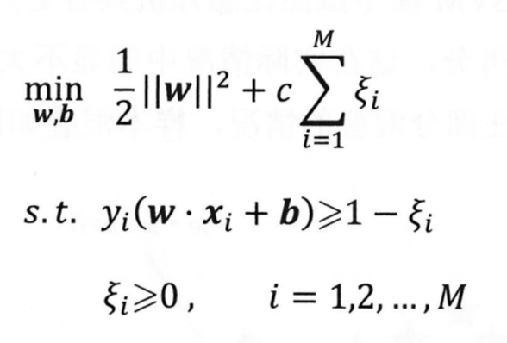

Slide 27
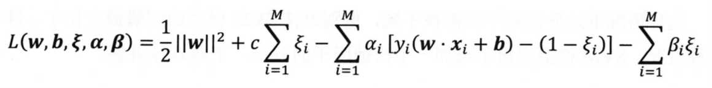

Slide 28
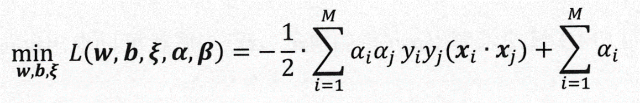

Slide 30
序列最小優化演算法
Sequential minimal optimization (SMO)
https://www.microsoft.com/en-us/research/wp-content/uploads/2016/02/tr-98-14.pdf
https://en.wikipedia.org/wiki/Sequential_minimal_optimization
Sequential minimal optimization (SMO) is an algorithm for solving the quadratic programming (QP) problem that arises during the training of support-vector machines (SVM).
It was invented by John Platt in 1998 at Microsoft Research.
SMO is widely used for training support vector machines and is implemented by the popular LIBSVM tool.The publication of the SMO algorithm in 1998 has generated a lot of excitement in the SVM community, as previously available methods for SVM training were much more complex and required expensive third-party QP solvers

Slide 31
可寫成

Slide 32
正則化項
合頁損失函數
Hinge Loss Function
https://zh.wikipedia.org/wiki/Hinge_loss

Slide 33
Non-linear Classification
非線性問題

Slide 35
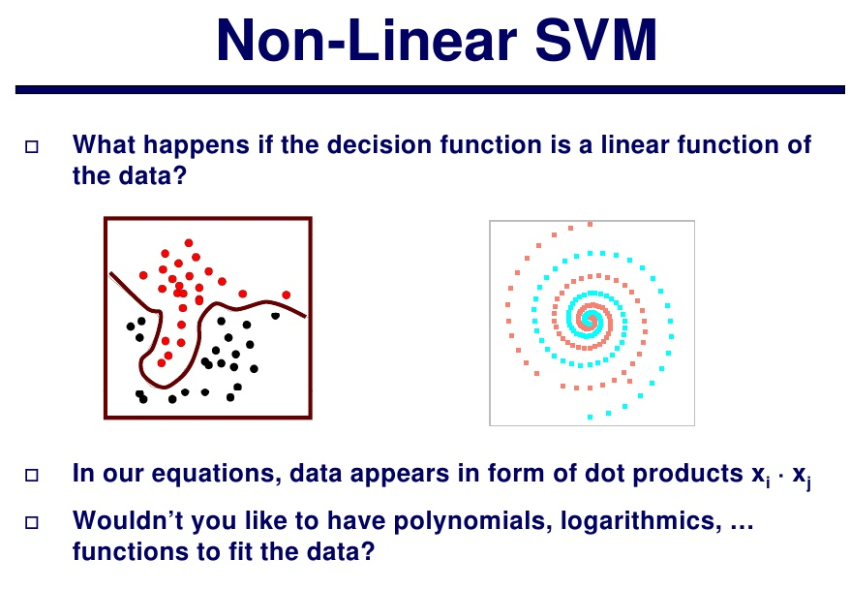
Lecture12 – SVM
https://www.slideshare.net/aorriols/lecture12-svm

Slide 36
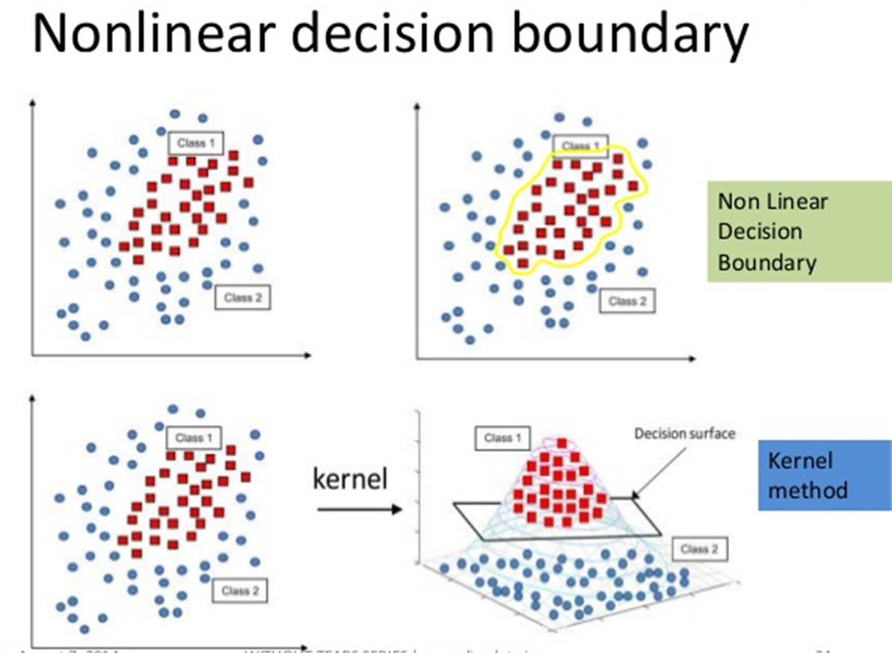
Support Vector Machine without tears
https://www.slideshare.net/ankitksharma/svm-37753690

Slide 38
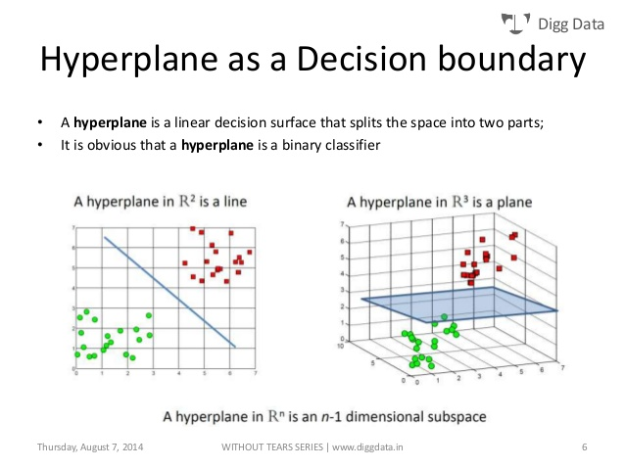
Support Vector Machine without tears
https://www.slideshare.net/ankitksharma/svm-37753690

Slide 41
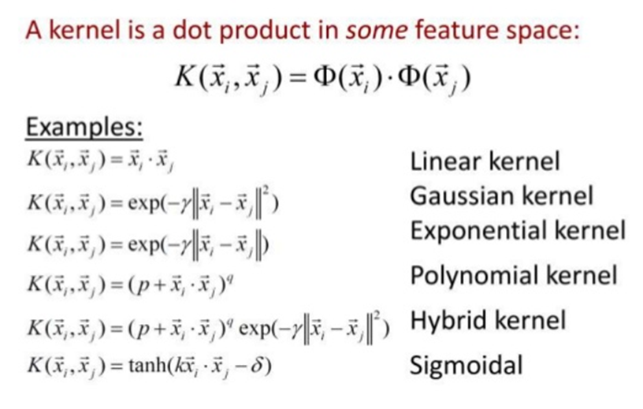

Slide 43
Sklearn_SVM

Slide 44
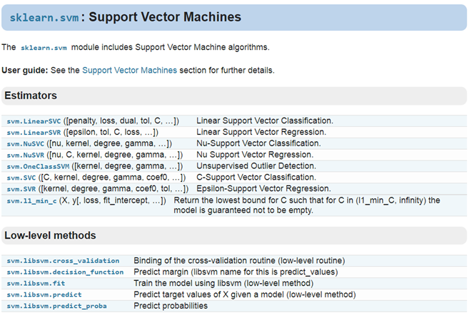
https://scikit-learn.org/stable/modules/classes.html

Slide 45
sklearn.svm.LinearSVC
https://scikit-learn.org/stable/modules/generated/sklearn.svm.LinearSVC.html#sklearn.svm.LinearSVC
class sklearn.svm.LinearSVC(
penalty=’l2’,
loss=’squared_hinge’,
dual=True,
tol=0.0001,
C=1.0,
multi_class=’ovr’,
fit_intercept=True,
intercept_scaling=1,
class_weight=None,
verbose=0,
random_state=None,
max_iter=1000)
Linear Support Vector Classification.
Similar to SVC with parameter kernel=’linear’, but implemented in terms of liblinear rather than libsvm, so it has more flexibility in the choice of penalties and loss functions and should scale better to large numbers of samples.
This class supports both dense and sparse input and the multiclass support is handled according to a one-vs-the-rest scheme.

Slide 46
正則化項
合頁損失函數
Hinge Loss Function
https://zh.wikipedia.org/wiki/Hinge_loss

Slide 47
sklearn.svm.LinearSVC
https://scikit-learn.org/stable/modules/generated/sklearn.svm.LinearSVC.html#sklearn.svm.LinearSVC
class sklearn.svm.LinearSVC(
penalty=’l2’,
loss=’squared_hinge’,
dual=True,
tol=0.0001,
C=1.0,
multi_class=’ovr’,
fit_intercept=True,
intercept_scaling=1,
class_weight=None,
verbose=0,
random_state=None,
max_iter=1000)
penalty : string, ‘l1’ or ‘l2’ (default=’l2’)
Specifies the norm used in the penalization.
The ‘l2’ penalty is the standard used in SVC.
The ‘l1’ leads to coef_ vectors that are sparse.
loss : string, ‘hinge’ or ‘squared_hinge’ (default=’squared_hinge’)
Specifies the loss function.
‘hinge’ is the standard SVM loss (used e.g. by the SVC class)
while ‘squared_hinge’ is the square of the hinge loss.

Slide 48
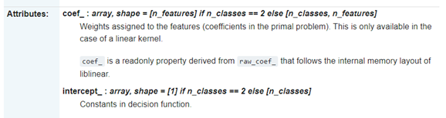

Slide 49
sklearn.svm.SVC
kernel : string, optional (default=’rbf’)
Specifies the kernel type to be used in the algorithm. It must be one of ‘linear’, ‘poly’, ‘rbf’, ‘sigmoid’, ‘precomputed’ or a callable.
預設是‘rbf’ =Radial basis function
（高斯）徑向基函數核
If a callable is given it is used to pre-compute the kernel matrix from data matrices; that matrix should be an array of shape (n_samples, n_samples).
class sklearn.svm.SVC(
C=1.0,
kernel=’rbf’,
degree=3,
gamma=’auto_deprecated’,
coef0=0.0,
shrinking=True,
probability=False,
tol=0.001,
cache_size=200,
class_weight=None,
verbose=False,
max_iter=-1,
decision_function_shape=’ovr’, random_state=None)

Slide 50
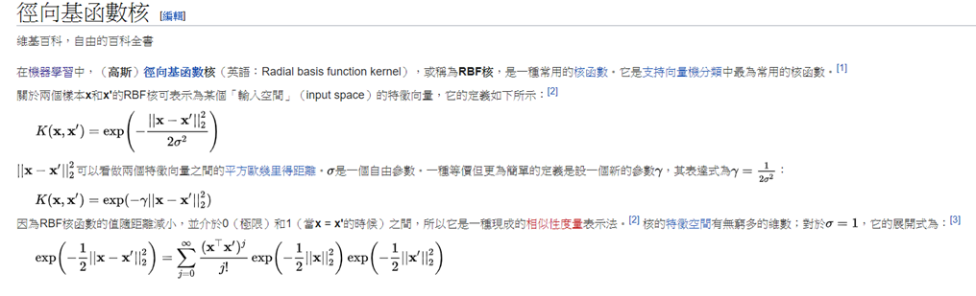
https://en.wikipedia.org/wiki/Radial_basis_function_kernel

Slide 51
sklearn.svm.SVC
class sklearn.svm.SVC(
C=1.0,
kernel=’rbf’,
degree=3,
gamma=’auto_deprecated’,
coef0=0.0,
shrinking=True,
probability=False,
tol=0.001,
cache_size=200,
class_weight=None,
verbose=False,
max_iter=-1,
decision_function_shape=’ovr’, random_state=None)
gamma : float, optional (default=’auto’)
Kernel coefficient for ‘rbf’, ‘poly’ and ‘sigmoid’.
Current default is ‘auto’ which uses 1 / n_features, if gamma='scale' is passed then it uses 1 / (n_features * X.var()) as value of gamma.
The current default of gamma, ‘auto’, will change to ‘scale’ in version 0.22. ‘auto_deprecated’, a deprecated version of ‘auto’ is used as a default indicating that no explicit value of gamma was passed.

Slide 52
sklearn.svm.SVC
class sklearn.svm.SVC(
C=1.0,
kernel=’rbf’,
degree=3,
gamma=’auto_deprecated’,
coef0=0.0,
shrinking=True,
probability=False,
tol=0.001,
cache_size=200,
class_weight=None,
verbose=False,
max_iter=-1,
decision_function_shape=’ovr’, random_state=None)
C : float, optional (default=1.0)
Penalty parameter C of the error term.
degree : int, optional (default=3)
Degree of the polynomial kernel function (‘poly’). Ignored by all other kernels.
decision_function_shape : ‘ovo’, ‘ovr’,
default=’ovr’

Slide 53
SVM==== FOR binary classification
How about Multi-class Classification??

Slide 54
SVM==== FOR binary classification
How about Multi-class Classification??
通過組合多個二分類器來實現多分類器的構造

Slide 55
SVM==== FOR binary classification
How about Multi-class Classification??
通過組合多個二分類器來實現多分類器的構造
a.一對多法（one-versus-rest,簡稱1-v-r SVMs, OVR SVMs）。
訓練時依次把某個類別的樣本歸為一類,其他剩餘的樣本歸為另一類，這樣k個類別的樣本就構造出了k個SVM。
分類時將未知樣本分類為具有最大分類函數值的那類。
b.一對一法（one-versus-one,簡稱1-v-1 SVMs, OVO SVMs, pairwise）
其做法是在任意兩類樣本之間設計一個SVM，因此k個類別的樣本就需要設計k(k-1)/2個SVM。
當對一個未知樣本進行分類時，最後得票最多的類別即為該未知樣本的類別。
Libsvm中的多類分類就是根據這個方法實現的。
https://blog.csdn.net/weixin_38100489/article/details/78363326

Slide 56
https://github.com/MyDearGreatTeacher/TensorSecurity/blob/master/data/iris.data
Sklearn_SVM_IRIS

Slide 57
https://github.com/MyDearGreatTeacher/TensorSecurity/blob/master/iris/Iris_scatter%E5%9C%96.md
import matplotlib.pyplot as plt
import numpy as np
from sklearn.datasets import load_iris #導入資料集iris
#載入資料集
iris = load_iris()
print(iris.data) #輸出資料集
print(iris.target) #輸出真實標籤
#獲取花卉兩列資料集
DD = iris.data
X = [x[0] for x in DD]
print(X)
Y = [x[1] for x in DD]
print(Y)
#plt.scatter(X, Y, c=iris.target, marker='x')
plt.scatter(X[:50], Y[:50], color='red', marker='o', label='setosa') #前50個樣本
plt.scatter(X[50:100], Y[50:100], color='blue', marker='x', label='versicolor') #中間50個
plt.scatter(X[100:], Y[100:],color='green', marker='+', label='Virginica') #後50個樣本
plt.legend(loc=2) #左上角
plt.show()

Slide 58
SVC_iris

Slide 59
from sklearn import svm
import numpy as np
import matplotlib.pyplot as plt
import matplotlib
import sklearn
from sklearn.model_selection import train_test_split

Slide 60
#define converts(字典)
def Iris_label(s):
it={b'Iris-setosa':0, b'Iris-versicolor':1, b'Iris-virginica':2 }
return it[s]

Slide 61
#1.讀取資料集
path='iris.data'
data=np.loadtxt(path, dtype=float, delimiter=',', converters={4:Iris_label} )
#converters={4:Iris_label}中“4”指的是第5列：將第5列的str轉化為label(number)
#print(data.shape)
#2.劃分資料與標籤
x,y=np.split(data,indices_or_sections=(4,),axis=1) #x為數據，y為標籤
x=x[:,0:2]
#sklearn.model_selection.
train_data,test_data,train_label,test_label =train_test_split(x,y, random_state=1, train_size=0.6,test_size=0.4)
#print(train_data.shape)

Slide 62
#3.訓練svm分類器
# ovr:一對多策略
classifier=svm.SVC(C=2,kernel='rbf',gamma=10,decision_function_shape='ovo')
#ravel函數在降維時預設是行序優先
classifier.fit(train_data,train_label.ravel())

Slide 63
#4.計算svc分類器的準確率
print("訓練集：",classifier.score(train_data,train_label))
print("測試集：",classifier.score(test_data,test_label))
#也可直接調用accuracy_score方法計算準確率
from sklearn.metrics import accuracy_score
tra_label=classifier.predict(train_data) #訓練集的預測標籤
tes_label=classifier.predict(test_data) #測試集的預測標籤
print("訓練集：", accuracy_score(train_label,tra_label) )
print("測試集：", accuracy_score(test_label,tes_label) )
#查看決策函數
print('train_decision_function:\n',classifier.decision_function(train_data)) # (90,3)
print('predict_result:\n',classifier.predict(train_data))

Slide 64
#5.繪製圖形
#確定坐標軸範圍
x1_min, x1_max=x[:,0].min(), x[:,0].max() #第0維特徵的範圍
x2_min, x2_max=x[:,1].min(), x[:,1].max() #第1維特徵的範圍

Slide 65
#生成網路採樣點
x1,x2=np.mgrid[x1_min:x1_max:200j, x2_min:x2_max:200j ]
grid_test=np.stack((x1.flat,x2.flat) ,axis=1) #測試點

Slide 66
#指定預設字體
matplotlib.rcParams['font.sans-serif']=['SimHei']
#設置顏色
cm_light=matplotlib.colors.ListedColormap(['#A0FFA0', '#FFA0A0', '#A0A0FF'])
cm_dark=matplotlib.colors.ListedColormap(['g','r','b'] )

Slide 67
# 預測分類值
grid_hat = classifier.predict(grid_test)
# 使之與輸入的形狀相同
grid_hat = grid_hat.reshape(x1.shape)

Slide 68
plt.pcolormesh(x1, x2, grid_hat, cmap=cm_light) # 預測值的顯示
plt.scatter(x[:, 0], x[:, 1], c=y[:,0], s=30,cmap=cm_dark) # 樣本
plt.scatter(test_data[:,0],test_data[:,1], c=test_label[:,0],s=30,edgecolors='k', zorder=2,cmap=cm_dark) #圈中測試集樣本點
plt.xlabel('花萼長度', fontsize=13)
plt.ylabel('花萼寬度', fontsize=13)
plt.xlim(x1_min,x1_max)
plt.ylim(x2_min,x2_max)
plt.title('鳶尾花SVM二特徵分類')
plt.show()

